Slide 1
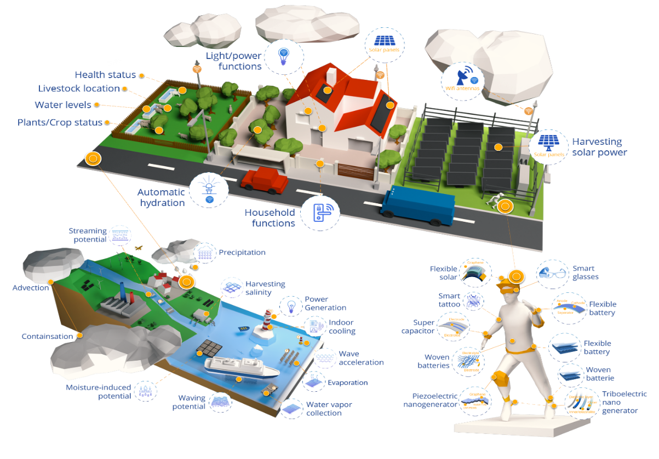


Nano@HMU Group at the Hellenic Mediterranean University / i-Emerge Institute
Development of solution processable 2D materials-enabled energy conversion technologies and emerging printed electronics integrated onto the same package toward self-powered hybrid chips for IoT and smart cities applications
Graphene and related 2D layered materials. Solution-phase processing of 2D materials for additive manufacturing platforms. Formulation of printable/sprayable 2D materials and multicomponent heterostructures with tailored properties through chemical functionalization and doping processes.
Organic & perovskite solar cells. Development of non-fullerene acceptors organic and perovskite solar cells. Interfacial engineering of solution processable solar cells for improved performance and stability.
Industrialization of emerging PVs. Development and engineering of transferable to industry roll-to-roll (R2R) and sheet-to-sheet (S2S) printing processes. Indoor and outdoor characterization and monitoring of PV modules and panels with IEC and ISOS protocols and correlation of environmental data with PV performance
Printed & Flexible electronics. Development of printed electronics (TFTs, foldable OLEDs, sensors), portable energy devices and assembly of self-powered, flexible platforms for agriculture, smart wearables, IoT and industry 4.0 applications.
Recent Research highlights
Nano@HMU with numbers
19 researchers
4 affiliated researchers
150 journal publications
40 invited talks in conferences
500m² of lab space
8 active research projects
9,5 M€ grants received
Group leader: Prof. E. Kymakis
Contact person: Assist. Prof. K. Rogdakis
More information:
https://nanohmu.gr
Emails: kymakis@hmu.gr , krogdakis@hmu.gr
Notes:
reports a sketch of the various functional roles of material components in SCs, as they will be detailed for each type of technology in the next sections. Clearly, solution-processed 2D-materials have been applied almost everywhere, most of them for more than one functionality. The most representative example material class, namely “graphene and derivatives”, has been used for all the functional roles here identified, indicating the importance to specify the structural, morphological and chemical properties for each material, thus using a “case-by-case approach”. I

