Slide 1



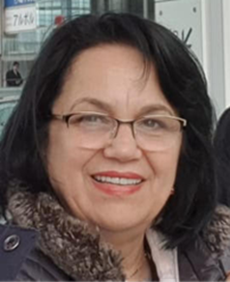
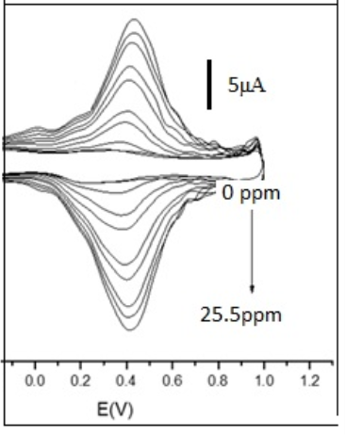

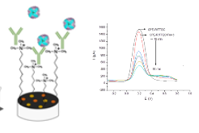
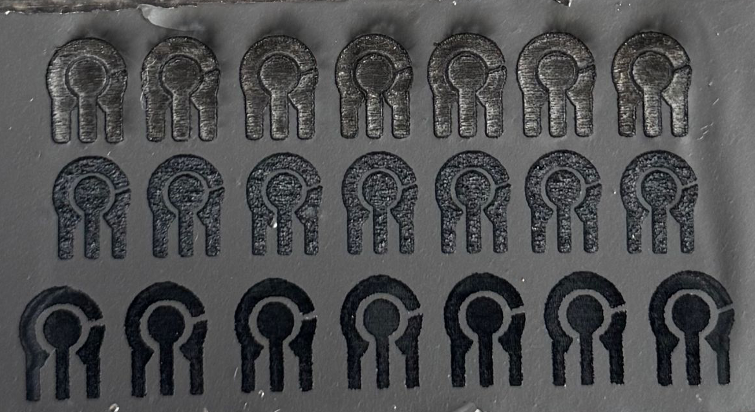
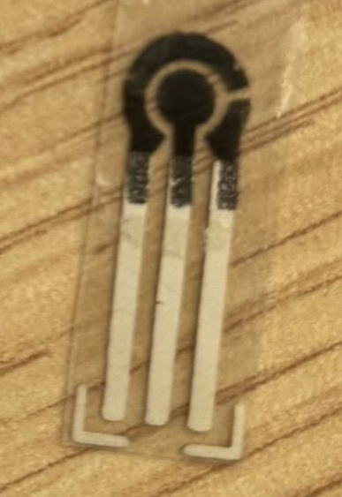
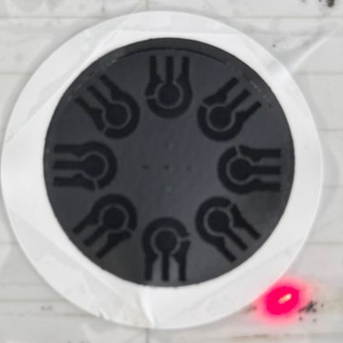
SENSORS AND BIOSENSORS USING NANOMATERIALS
Contact person/Group leader:
Prof. Dr. Majlinda Vasjari
Affiliation
Department of Chemistry, Faculty of Natural Sciences, University of Tirana, Albania
Mail address
Office 308, building A, blv. Zogu I, No. 25/1, 1001 Tirana, Albania
Email/website
majlinda.vasjari@fshn.edu.al;
https://sites.google.com/a/fshn.edu.al/departamenti-i-kimisee/personelli/profdr-Majlinda-Vasjari
Group Members
Prof. Dr. Majlinda Vasjari; Dr. Nevila Broli; Msc. Sadik Cenolli; Msc. Lueda Kulla; Msc. Ana Ameda
Google Scholar
https://scholar.google.com/citations?hl=en&user=q6HWFx4AAAAJ
Research Gate
https://www.researchgate.net/profile/Majlinda_Vasjari
Research lines
Affinity sensors based on nano- Au film for Hg vapor
Sensors based on surface modifications of GC electrode for HMs determinations
Composite sensors based on CNT modification for antibiotic determinations
Screen-printed electrodes for determination of amino acids, histamine and heavy metals
Development of enzymatic biosensors based on crude tissue of plants and Au NP
Membrane modified potentiometric sensor for determination of anions in environmental samples
Imunosensor for ferritin in blood serum
Aptasensors development for antibiotics determination
Application of printing technologies for nanosensors (laser printing, screen printing &inject printing)

