Slide 1



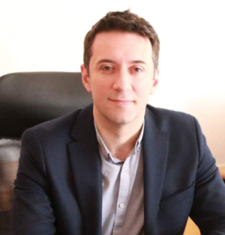
DIGITAL SOLUTIONS IN HEALTH & THERAPEUTICS GROUP
Contact person/Group leader:
Prof. Asoc. Dr. Kreshnik Hoti
Affiliation
Division of Pharmacy, Faculty of Medicine, University of Prishtina, Kosovo
Mail address
Rr. Bulevardi i Dëshmorëve, p.n. 10 000 Prishtinë, Republika e Kosovës.
Email/website
kreshnik.hoti@uni-pr.edu
Group Members
Prof. Asoc. Dr. Kreshnik Hoti, Dr Valdet Uka, Dr Dardan Hetemi, Mr Ph Hyllore Imeri
Mr Ph Denis Raka, Lekë Kryeziu
Google Scholar
https://scholar.google.com/citations?user=C1hMK2oAAAAJ&hl=en
Research Gate
https://www.researchgate.net/profile/Kreshnik-Hoti
Research lines
Digital solutions solving health related challenges
mHealth applications
Artificial intelligence in health
Pain assessment
Medication administration and safety
Pharmacy practice

