Slide 1



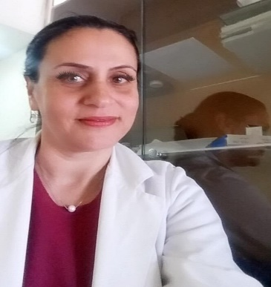
NANOTECHNOLOGY IN PHARMACEUTICALS AND MEDICINE - APPLICATIONS GROUP
Contact person/Group leader:
Dr. Kleva SHPATI
Affiliation
Department of Pharmacy, Faculty of Medical Science , Albanian University, Albania
University of Medicine , Faculty of Medicine, Tirana Albania
Mail address
Rruga Kajo Karafili, Nr 23 , 1001 Tirana, Albania, Rruga e Dibres, Tirana-Albania
Email/website
k.shpati@albanianuniveristy.edu.al
Group Members
Dr. Kleva Shpati; Dr. Delina Xhafaj; Assoc.Prof. Dr. Edi Grabocka; Assoc. Prof. Dr. Nard Deda; Assoc. Prof. Dr. Entela Haloci; Dr. Albana Halili; Assoc. Prof. Dr. Aida Dama
Research lines
Pharmaceuticals and Drug Delivery System for optimizing therapy expert evaluations
Dendric platform for cytostatic experts
Encapsulations of phytocompounds
Harmonization of legislation through science requirements, drug evaluation.
Drug delivery system experts.
Drug master files evaluation
Researches in applied bioavailability, bioequivalence study (in vitro)

