Slide 1



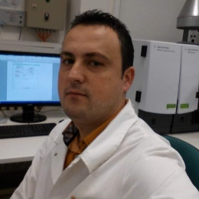
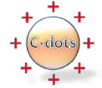
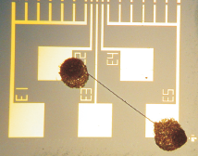
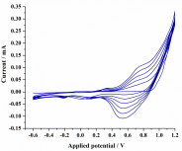
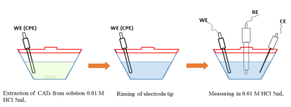
NANO, MICRO MATERIALS AND SENSORS FOR TECHNICAL AND ENVIRONMENTAL
APPLICATIONS GROUP
Contact person/Group leader:
Prof. Dr. rer. nat. Kledi XHAXHIU
Affiliation
Department of Chemistry, Faculty of Natural Sciences, University of Tirana, Albania
Mail address
Office 330, building A, blv. Zogu I, No. 25/1, 1001 Tirana, Albania
Email/website
kledi.xhaxhiu@fshn.edu.al; kledi.xhaxhiu@unitir.edu.al
https://sites.google.com/a/fshn.edu.al/departamenti-i-kimisee/personelli/profdr-Kledi-Xhaxhiu
Group Members
Prof. Dr. rer. nat. Kledi Xhaxhiu; MSc. Nensi Isak; MSc. Muhamed Farruku,
BSc. Tomas Shyta
Google Scholar
https://scholar.google.com/citations?user=J4fDUaIAAAAJ&hl=en
Research Gate
https://www.researchgate.net/profile/Kledi_Xhaxhiu
Research lines
Syntheses and characterization of solid state nano/micro sensors for various applications (gas, light), thermoelectrics, photovoltaics, composite materials and conductive polymers for optoelectronics.
Unmodified and modified CPE and SPE for electroactive bio-organics.
C-dots and magnetic particle syntheses and characterizations for various biological applications.
Natural, synthetic and chemically modified layered materials (clays, birnessites, buserites, todorokites) for environmental applications.
Sub- and supercritical fluids of plants and fruits, characterization of the extract properties.
Consolidation/strengthening of solid building materials with inorganic/organic coatings.

