Slide 1



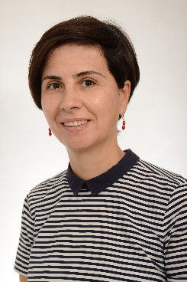
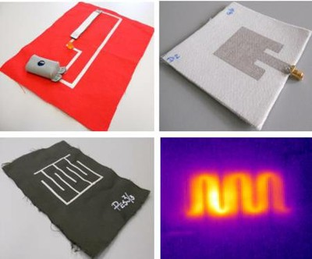
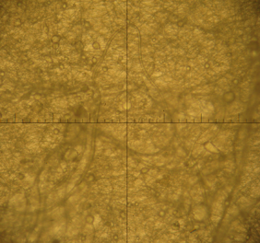
Nanotechnology in Textiles
Contact person:
Prof. Assoc. PhD. Ilda Kazani
Affiliation
Department of Textile & Fashion, Faculty of Mechanical Engineering, Polytechnic
University of Tirana, Albania
Mail address
Sheshi Nënë Tereza, Nr. 1, 1000 Tirana, Albania
Email/website
ikazani@fim.edu.al, mhylli@fim.edu.al tspahiu@fim.edu.al, gguxho@fim.edu.al;
http://www.upt-tekstilmoda.org
Group Members
Ilda Kazani, Majlinda Hylli, Aulon Shabani, Genti Guxho, Tatjana Spahiu.
Google Scholar
https://scholar.google.com/citations?hl=en&user=V6D6sKMAAAAJ,
Research Gate
https://www.researchgate.net/profile/Ilda_Kazani; http://www.akad.gov.al/ash/akademia-e-te-rinjve/anetaret
Research lines
Textiles sensors through screen printing with nanoconductive inks for health
care applications.
Needleless Electrospinning of PAN Fibers.
E-fiber electrospinning of recycle Polyethylene Terephthalate (PET).
Electroconductive leather

