Slide 1



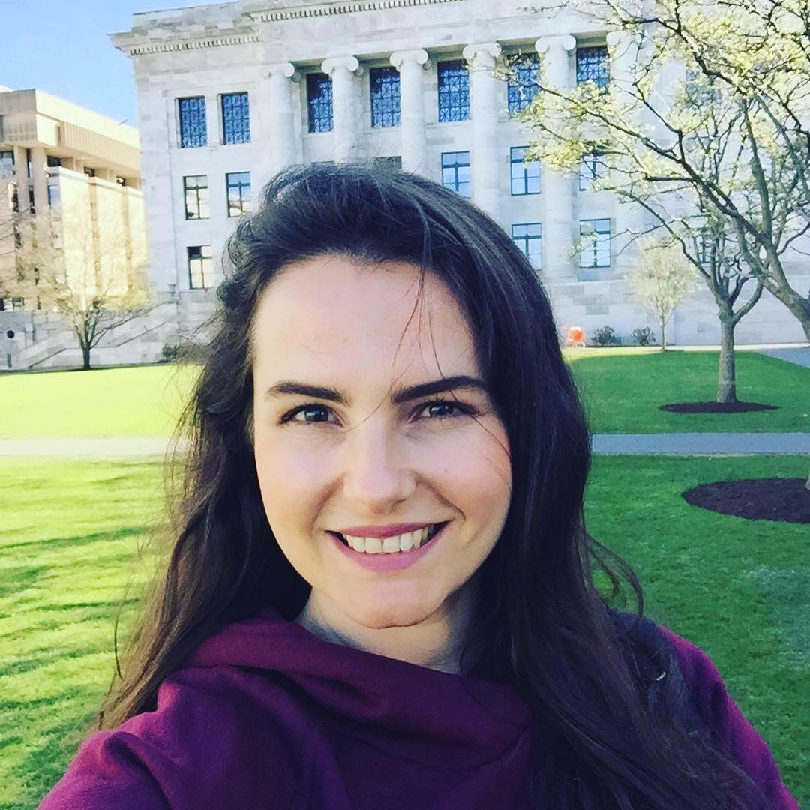
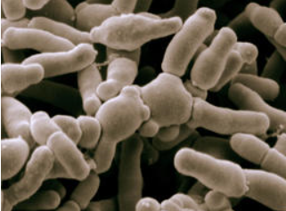
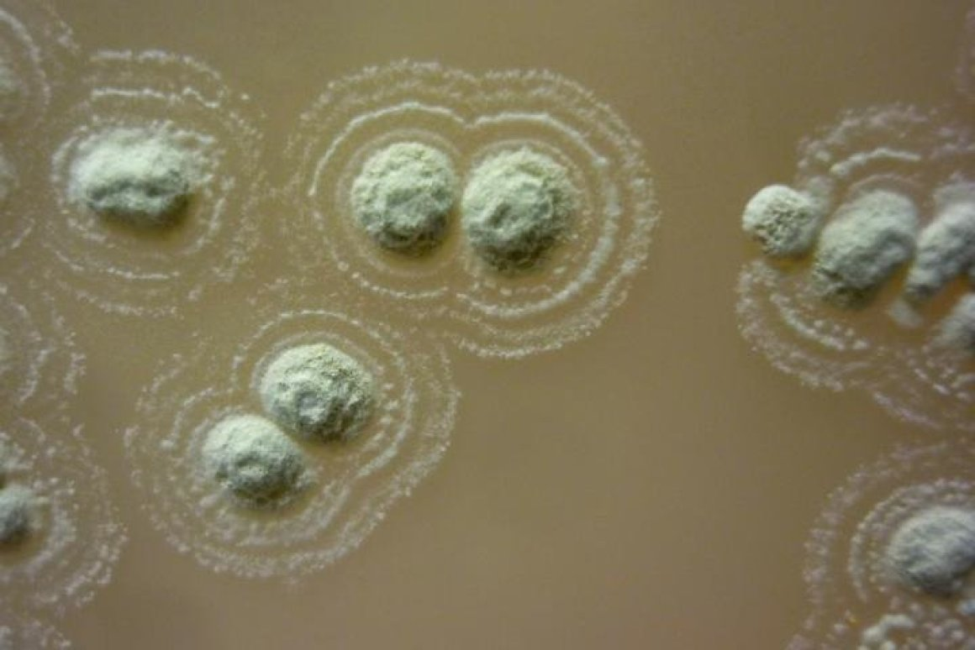
NANOTECHNOLOGY IN NATURAL PRODUCTS
Contact person/Group leader:
Dr. Entela Hodaj-Çeliku
Affiliation
Department of Chemistry, Faculty of Biotechnology and Food, AUT, Albania
Mail address
Rruga “Paisi Vodica, Kodër-Kamëz, Tiranë
Email/website
ehodaj@ubt.edu.al www.ubt.edu.al
Group Members
Dr. Entela Çeliku; Dr. Nertil Xhaferaj; Dr. Erjon Mamoci, MSc. Elton Basha
Google Scholar
https://scholar.google.com/citations?user=4B1fRa4AAAAJ&hl=en
Research Gate
https://www.researchgate.net/profile/Entela-Hodaj
Research lines
Isolation and structure of natural products. The research group studies biologically active small molecules in their natural, as opposed to therapeutic, context, and the small molecules that serve as biological information carriers are of special interest.
Essential oils loaded in nanosystems for food preservation.
Microbial natural products.
Marine natural products.
Human microbiome: Mining the gut microbiome for immunomodulatory molecules.
Functional material for food and packing industry.
Porous material for food waste absorption and recovery

