Slide 1



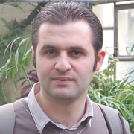
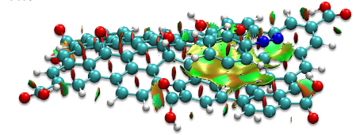
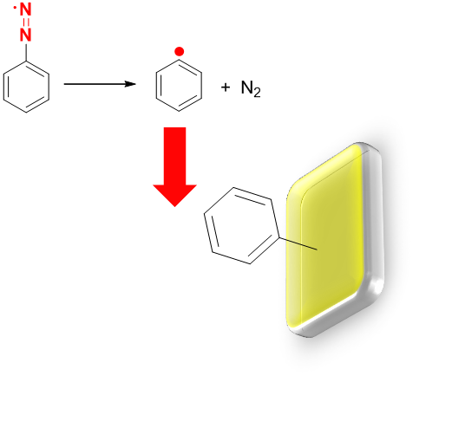
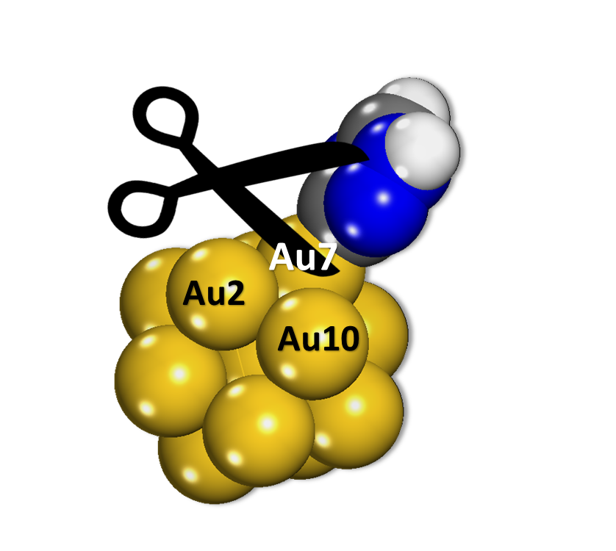
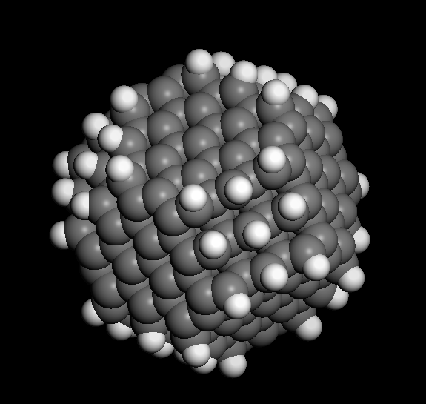
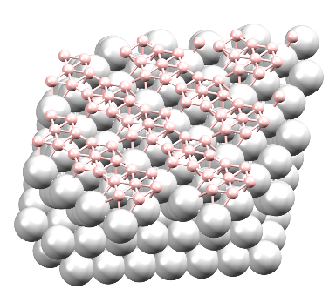
MATERIALS SCIENCE - NANOCHEMISTRY RESEARCH GROUP
Contact person/Group leader:
Prof. dr. Avni BERISHA
Affiliation
Department of Chemistry, FNMS, University of Prishtina, Kosovo
Mail address
Universiteti i Prishtinës, FSHMN, Rr. "Nëna Terezë" p.n.10 000 Prishtinë, Kosovë
Email/website
avni.berisha@uni-pr.edu // https://staff.uni-pr.edu/profile/avniberisha
Group Members
Prof. dr. Avni Berisha, Prof. dr. Fetah Podvorica, Prof. dr. Ramë Vataj, Prof.ass.
Makfire Sadiku, Dr.sc. Jeton Halili, Dr. sc.Valbonë Mehmeti, MSc. Veprim Thaqi, PhD
Google Scholar
https://scholar.google.com/citations?user=YvvfjecAAAAJ&hl=en
Research Gate
https://www.researchgate.net/profile/Avni_Berisha
Research lines
Synthesis, characterization and application of 0 D (clusters, nanoparticle, quantum dots) and 2D (graphene oxide, graphene) nanomaterials
Surface modification of materials (bulk, powdered or nanomaterials – insulator, semi-conductor or conducting ones) by 2D nanometric covalently bonded thin films using the diazonium chemistry
Theoretical calculations based on quantum and molecular mechanics (both atomistic, molecular and periodic systems) to explore the behavior of nanomaterials (bare and grafted surfaces) and molecules (wavefunction analysis), to evaluate the nature of the grafted molecules, binding strength, solvation properties, diffusion/permeation of gasses and small molecules into materials
The use of the grafted layers, organic inhibitors, nanomaterials (carbon quantum dots, crystalline nanocellulose and graphene) and expired drugs for corrosion protection of materials (including electrochemical measurements and Molecular Dynamic + Monte Carlo calculations)

