Slide 1



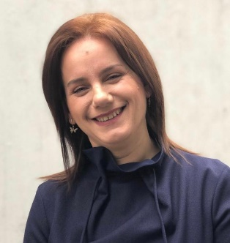
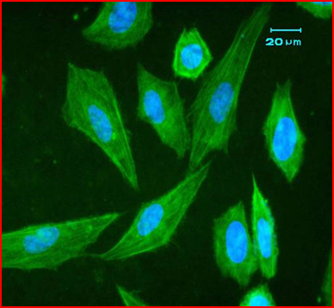
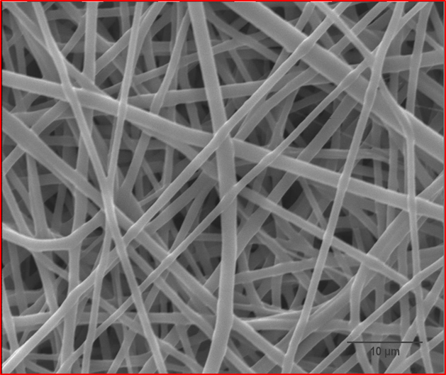
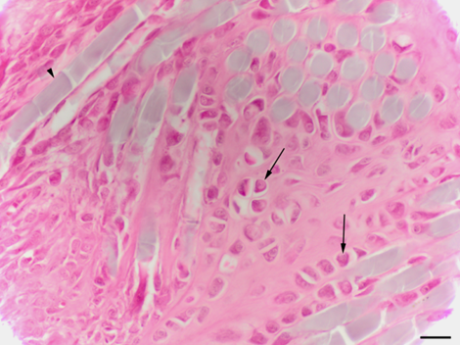
NANOBIOMATERIALS AND TISSUE ENGINEERING RESEARCH GROUP
Contact person/Group leader:
Assoc. Prof. Dr. Albana Ndreu Halili
Affiliation
¹Department of Medicine, ²Department of Biosciences and Engineering, Western Balkans University, Tirane, Albania
Mail address
Rr. Qafe Kashar Rinas, Km 7, Tirane, Albania
Email/website
albana.halili@wbu.edu.al; ndreualbanah@gmail.com
Group Members
Assoc. Prof. Albana Halili; Dr. Ida Kokalari; MSc. Adora Hima; BSc. Tea Mankollari; BSc. Meri Zalla; Assoc. Prof. Arban Uka; PhD Cand Xhoena Polisi
Google Scholar
https://scholar.google.com/citations?hl=en&user=Whf1zTkAAAAJ
Research Gate
https://www.researchgate.net/profile/Albana_Ndreu
Research lines
Tissue engineering and regenerative medicine
Synthesis, fabrication and characterization of natural and synthetic electrospun polymeric nano-microfibers; Surface modification studies on polymeric structures
Nanomedicine; Biomimetics and drug delivery systems
Biomedical Imaging (image analysis and imaging systems) and Modelling (in collaboration with Assoc. Prof. Arban Uka and PhD Cand. Xhoena Polisi)

